Slide 1
PROCEDURE & MACROS

Slide 2
Writing and using Procedures
To avoid writing the sequence of instructions in the program each time you need them, you can write the sequence as a separate subprogram called a procedure.
Each time the sequence of instructions needs to be executed, CALL instruction can be used.
CALL instruction transfers the execution control to procedure.
In the procedure, a RET instruction is used at the end.
This will cause the execution to be transferred to caller program.

Slide 3
The CALL and RET instructions
The CALL Instruction:
  Stores the address of the next instruction to be executed after the CALL instruction to stack. This address is called as the return address.
  Then it changes the content of the instruction pointer register and in some cases the content of the code segment register to contain the starting address of the procedure.

Slide 4
Contd..
A RET instruction at the end of the procedure returns execution to the next instruction in the main line
Procedures can even be nested

Slide 5
MAINLINE OR CALLING
PROGRAM
PROCEDURE
INSTRUCTIONS
CALL
NEXT MAINLINE
INSTRUCTIONS
RET
Fig. Single Procedure Call

Slide 6
Main Line Instructions
Lower level
Procedure
Procedure
CALL
CALL
Next Main Line
Instructions
RET
RET
Fig. Nested Procedures Call

Slide 7
The CALL Instruction Overview
The 8086 CALL instruction performs 2 operations when it executes
First, it stores the address of the instruction after the CALL instruction on the stack
This address is called the return address because it is the address that execution will return to after the procedure executes

Slide 8
Contd..
If the CALL is to a procedure in the same code segment, then the call is near, and only the instruction pointer contents will be saved on the stack
If the CALL is to a procedure in another code segment, the call is far ; In this case both the instruction pointer and the code segment register contents will be saved on the stack

Slide 9
Contd..
Second operation of the CALL instruction is to change the contents of the instruction pointer and, in some cases, the contents of the code segment register to contain the starting address of the procedure

Slide 10

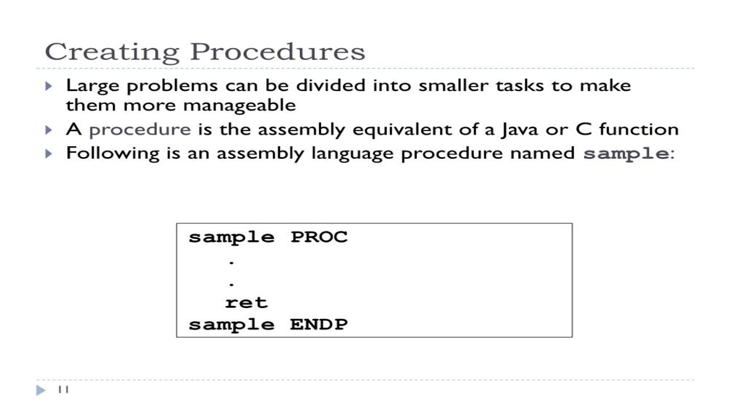

Slide 11
Defining procedures
Assembler provides PROC and ENDP directives in order to define procedures.
The directive PROC indicates beginning of a procedure.
Its general form is:
Procedure_name PROC [NEAR|FAR]
All procedures are defined in code segment.
The directive ENDP indicates end of a procedure.
Its general form is:
        Procedure_name ENDP

Slide 12
For example,
      Factorial PROC NEAR
      . . .. . .. . .
      Factorial ENDP

Slide 14
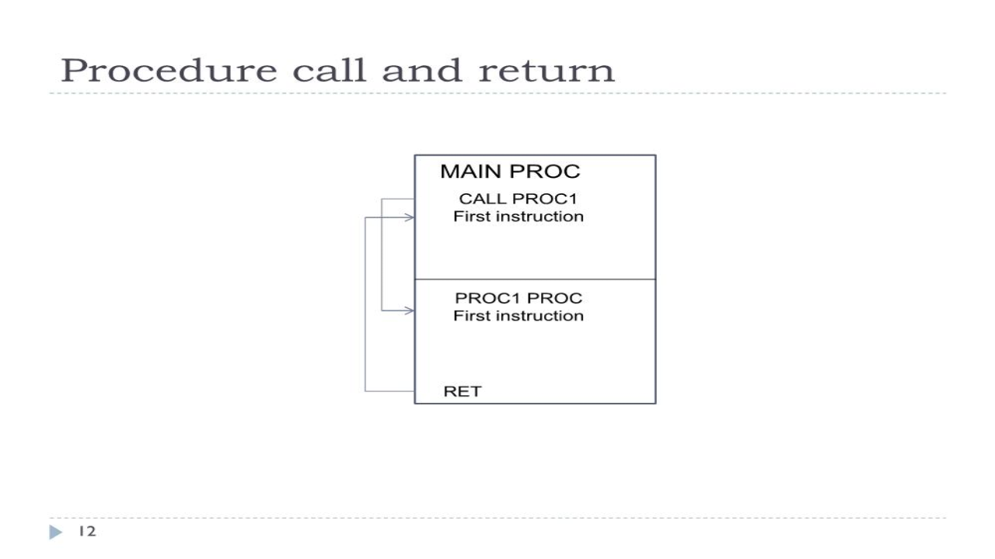

Slide 15
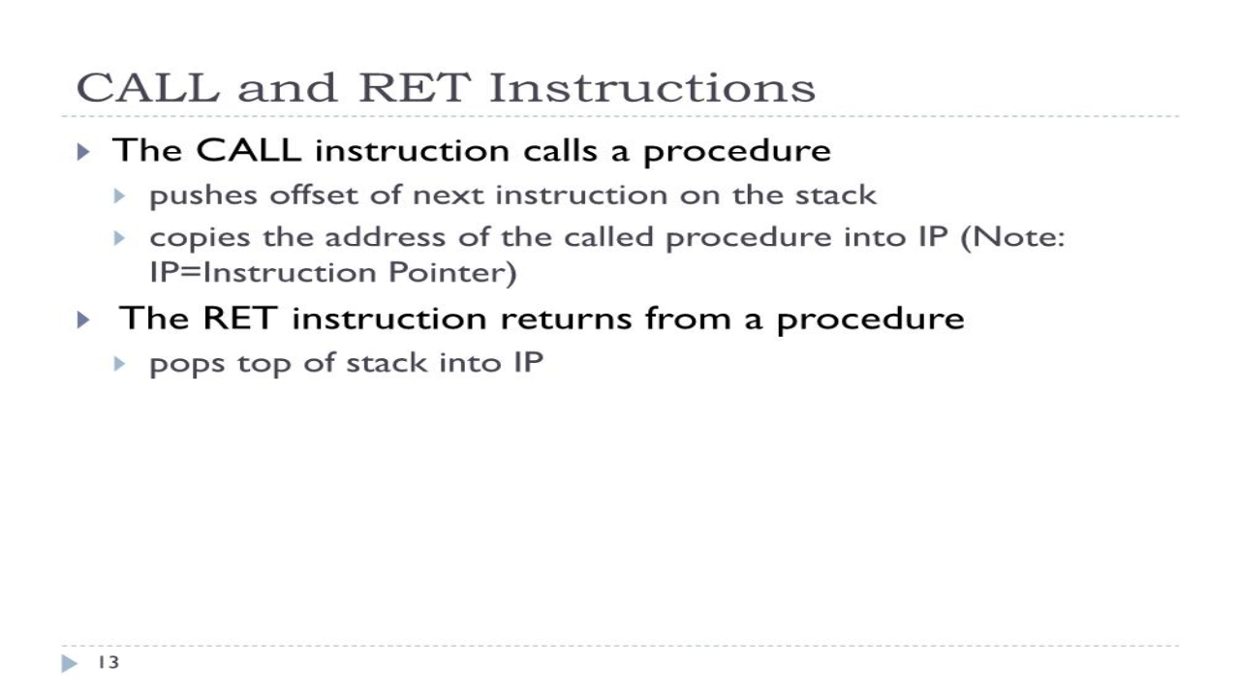

Slide 16
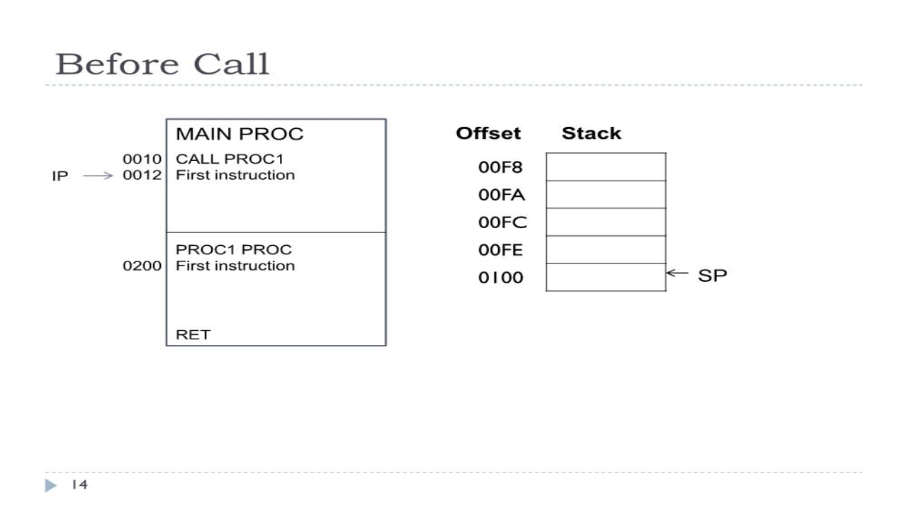

Slide 17
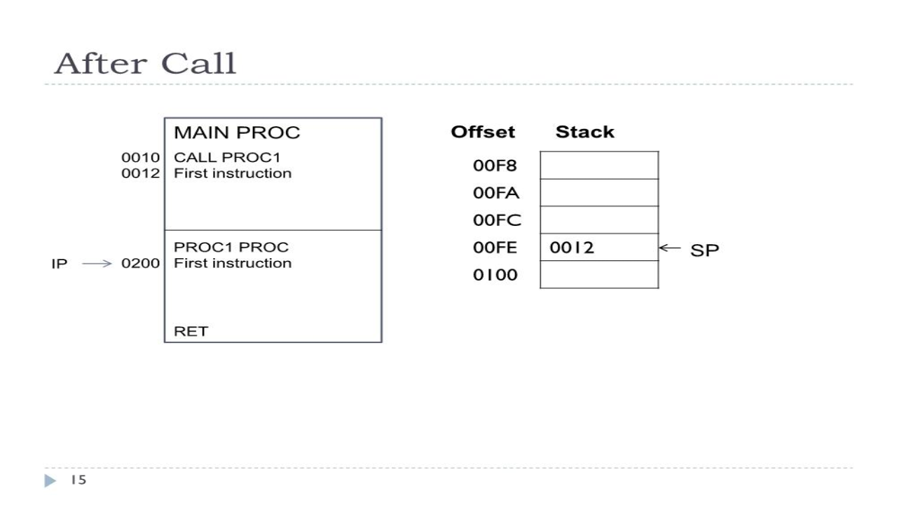

Slide 18
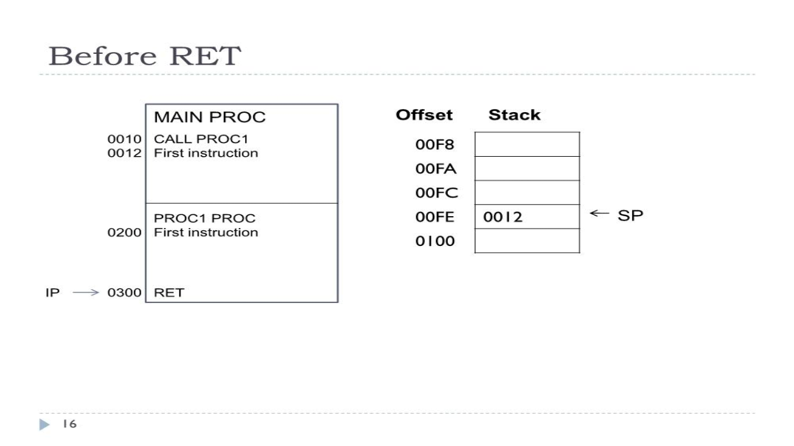

Slide 19
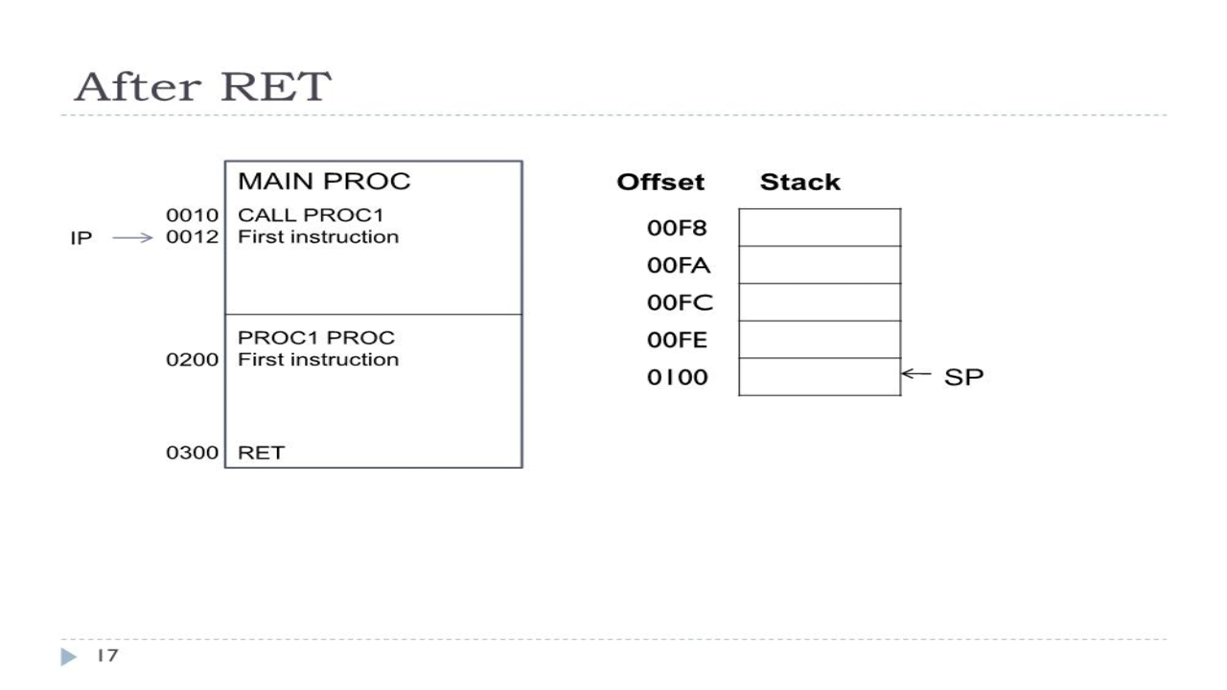

Slide 20
Types of CALL
WITHIN-SEGMENT NEAR CALL: produce the starting address of the procedure by adding a 16-bit signed displacement to the contents of the instruction pointer.
INTERSEGMENT FAR CALL: used when the called procedure is in different segment.

Slide 21
Difference between NEAR and Far
NEAR
  Within Same CS
  Replace old IP with new IP
  Value of IP is Pushed on the stack
  Also called as Intrasegment call
FAR
  Within Different CS
  Replace old pair CS:IP with new pair
  Value of pair CS:IP is Pushed on the stack
  Also called as Intersegment call

Slide 22
The 8086 RET Instruction
A return at the end of the procedure copies this value from the stack back to the instruction pointer to return execution to the calling program
When the 8086 does a far call, it saves the contents of both the instruction pointer and the code segment register on the stack

Slide 23
Contd..
A RET instruction at the end of the procedure copies these values from the stack back into the IP and CS register to return execution to the mainline program

Slide 24
8086 Stack
8086 lets us to set aside entire 64 KB segment of memory as a stack
The stack segment register is used to hold the upper 16 bits of the starting address you give to the stack segment
8086 produces the physical address for a stack location by adding the offset contained in the SP register to the stack segment base address represented by the 16-bit number in the SS register

Slide 25
Contd..
SP register is automatically decremented by 2 before a word is written to the stack
This means that at the start of your program you must initialize the SP register to point to the top of the memory you set aside as a stack rather than initializing it to point to the bottom location

Slide 26
Contd..
When a near RET instruction executes, the IP value stored in the stack will be copied back to the IP register and the SP register will be automatically incremented by 2
After a CALL-RET sequence, then, the SP register is again pointing to the initial top-of-stack location

Slide 27
Contd..
STACK_SEG SEGMENT STACK
DW 40 DUP(0)
STACK_TOP LABEL WORD
STACK_SEG ENDS
CODE SEGMENT
ASSUME CS:CODE, SS:STACK_SEG

Slide 28
Contd..
START:
MOV AX, STACK_SEG
MOV SS, AX
LEA SP, STACK_TOP
.
.
CODE ENDS
END START

Slide 29
Passing Parameters to and from Procedures
Often when we call a procedure, we want to make some data values or addresses available to the procedure
Likewise, we often want a procedure to make some processed data values or addresses available to the main program

Slide 30
CODE SEGMENT
ASSUME CS:CODE, DS:DATA
START:
MOV AX, DATA
MOV DS, AX
MOV AL, 01H
MOV BL, N
CALL FACTORIAL
MOV FACT, AX
MOV AH, 4CH
INT 21H
FACTORIAL PROC NEAR
AGAIN:
MUL BL
DEC BL
JNZ AGAIN
RET
FACTORIAL ENDP
CODE ENDS
END START
DATA SEGMENT
N DB 05H
FACT DW ?
DATA ENDS

Slide 31
Contd..
The 4 major ways of passing parameters to and from a procedure are:
  Using global declared variable
  Using registers of CPU architecture
  Using memory location
  Using stack
  Using public and extern

Slide 32
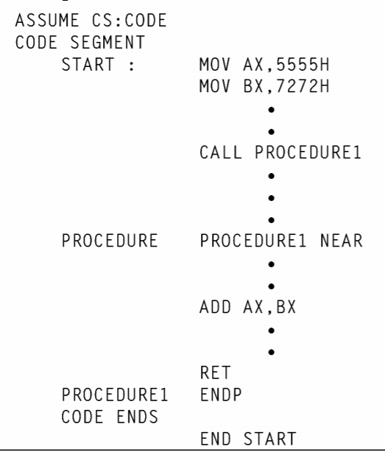
Using registers of CPU architecture

Slide 33
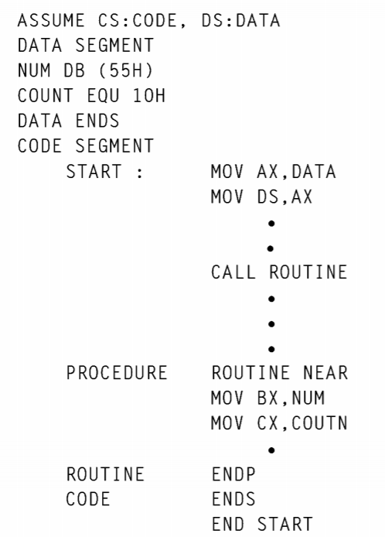
Using memory location

Slide 34
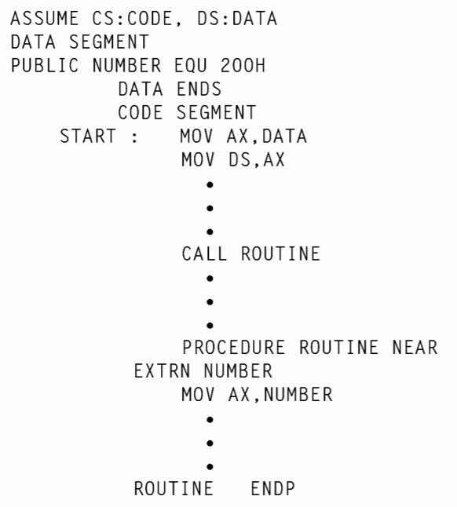
Using public and extern

Slide 35
Contd..
PROCEDURE FACTO
IF N = 1
FACTORIAL = 1
RET
ELSE
REPEAT
DECREMENT N
CALL FACTO
UNTIL N=1
MULTIPLY (N-1)! X PREVIOUS N
RET

Slide 36
Writing and Calling Far Procedures
A FAR procedure is one that is located in a segment which has a different name from the segment containing the CALL instruction
To get the starting address of a far procedure, the 8086 must change the contents of both the Code Segment register and the Instruction Pointer

Slide 37
Contd..
At the end of the far procedure, both the contents of the code segment register and the contents of the instruction pointer must be popped off the stack to return to the calling program

Slide 38
Contd..
CODE SEGMENT
ASSUME CS:CODE, DS:DATA, SS:STCK_SEG
:
CALL MULTIPLY_32
:
CODE ENDS

Slide 39
Contd..
PROCEDURES SEGMENT
MULTIPLY_32 PROC FAR
ASSUME CS:PROCEDURES
:
:
MULTIPLY_32 ENDP
PROCEDURES ENDS

Slide 40
Advantages & Disadvantages
Advantages
  Programming becomes simple.
  Reduced development time as each module can be implemented by different persons.
  Debugging of smaller programs and procedures is easy.
  Reuse of procedures is possible.
Disadvantage
Processor needs to do extra work to save status of current procedure and load status of called procedure.

Slide 41
MACROS
Whenever it is required to use a group of instructions several times in a program, there are two ways to use that group of instructions:
    Procedure
    Macro
A macro is a group of instructions to which a name is given.
Each time a macro is called in a program, the assembler will replace the macro name with the group of instructions.

Slide 42
Advantages
  Macro reduces the amount of repetitive coding.
  Program becomes more readable and simple.
  Execution time is less as compared to calling procedures.
  Reduces errors caused by repetitive coding
Disadvantage of macro is that the memory requirement of a program becomes more.

Slide 43
Comparison Macros and Procedures
A big advantage of using procedures is that the machine codes for the group of instruction in the procedures needs to be loaded in to main memory only once.
Disadvantage using the procedures is the need for the stack.
A macro is the group of instruction we bracket and give a name to at the start of the program.
Using macro avoids the overhead time involved in calling and returning from a procedures.

Slide 45
Defining and Calling a Macro Without Parameters
Before using macros, we have to define them.
Macros are defined before the definition of segments
Macro Definition:
MACRO-NAME MACRO
; MACRO DEFINITION
;
ENDM
Invoking a Macro:
MACRO-NAME

Slide 46
Example
Macro Definition:
CLRSCR MACRO
MOV AH, 00H
MOV AL, 02H
INT 10H
ENDM
Macro Invocation:
CLRSCR

Slide 47
Defining and calling a Macro with parameters
Syntax :
    NameMacro MACRO [parameter1, parameter2...]
    Code of the macro
    ENDM

Slide 48
Passing Parameters to Macros
Example:
Macro definition:
SETCURSOR MACRO X, Y
MOV DL, Y
MOV DH, X
MOV BH, 00H
MOV AH, 02H
INT 10H
ENDM

Slide 49
Contd..
If the macro invocation statement is SETCURSOR 12, 40 then the macro will be replaced by:
MOV DL, 40
MOV DH, 12
MOV BH, 00H
MOV AH, 02H
INT 10H

Slide 50
Addition of two 16-bit numbers using macro
ADDITION MACRO NO1, NO2, RESULT
  MOV AX, NO1
  MOV BX, NO2
  ADD AX, BX
  MOV RESULT, AX
ENDM
ASSUME CS:CODE, DS:DATA
DATA SEGMENT
  NUM1 DW 1000H
  NUM2 DW 2000H
  RES DW ?
DATA ENDS
CODE SEGMENT
START: MOV AX, DATA
  MOV DS, AX
  ADDITION NUM1, NUM2, RES
  MOV AH, 4CH
  INT 21H
CODE ENDS
END START

